Slide 1

Group 16
Predictive analytics Using SAS
Srg
Savrin Darash
Karan Bhujbal
Jinx Mei
Rohanjit Singh Virdi
Prarthna Vasudevamurthy

Slide 2
Company’s objectives
WE TAKE FOOD SERIOUSLY
Professional chefs on staff, amateur foodies on call.
WE SEE ART IN UNEXPECTED PLACES
Statement making sneakers, one of a kind swag.
WE LIVE TO SKI/SHRED
Bragging aside, we're pretty awesome.
YOU DON'T HAVE TO BE YOUNG TO BE IDEALISTIC
We're 30 years old and still living our values.
WE LOVE OUR DOGS
At last count we had 40+ office dogs.
WE GIVE CHEERS
It's 11a.m. or 5 o'clock somewhere.
Health conscious culinary
Sport and exercise
Animal friendliness
Beverages
Company’s values
& Interests

Slide 3


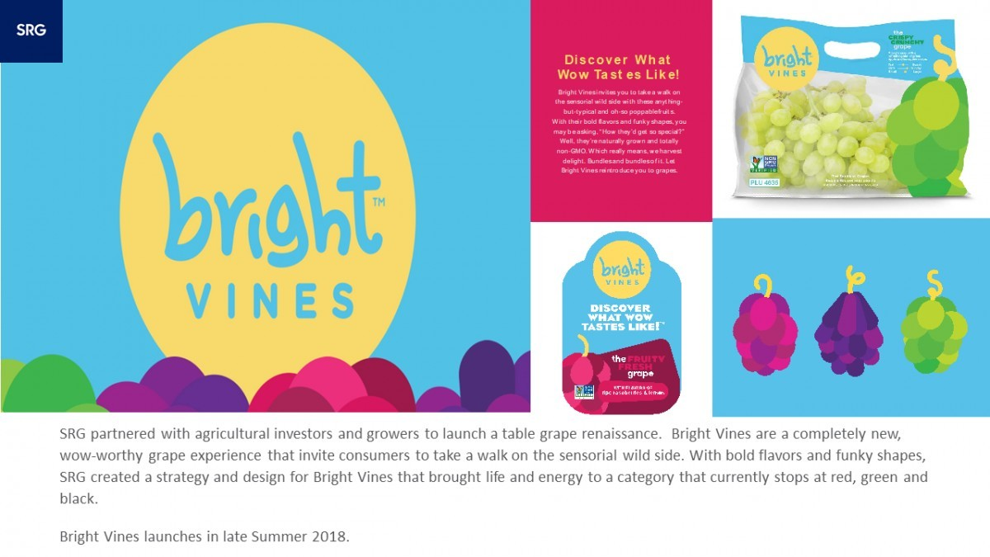
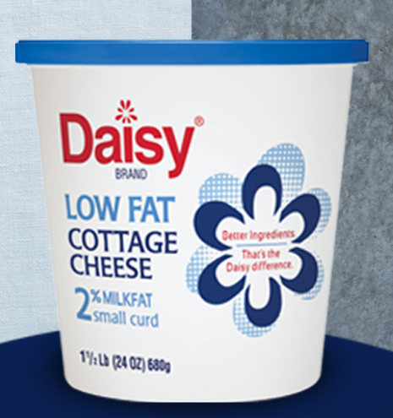




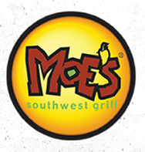
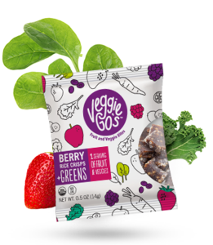



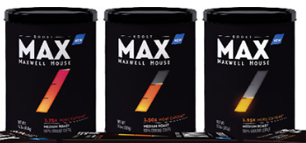

SRG’s costumers and services
BRAND DESIGN
PACKAGING DESIGN
BRAND POSITIONING
CULINARY TRENDS & MAPPING
ENVIRONMENTAL DESIGN
BRAND STRATEGY
CONSUMER INSIGHTS

Slide 4
SRG Proprietary Study 2015
What is it about ? Health and wellness.
The survey is made up of 30 questions consisting of questions about Personal information such as age, gender, income, and ethnicity (demographic data)
There are questions about the wellness and lifestyle( attitudinal and motivation data).
There are also questions on food and snack choices and frequency and time of their consumption
With focus on dinner and time and energy that customer is willing to invest on making it.

Slide 5
Health
In 1946, the World Health Organization (WHO) defined health as “a state of complete physical, mental, and social well-being, and not merely the absence of disease or infirmity.”
Measures of
physical Health
from the dataset
Such as :
Weight
Height
BMI

Slide 6
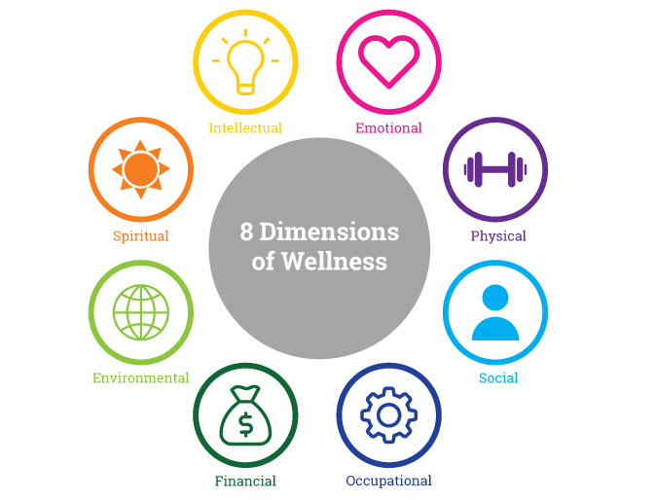
Wellness
The Global Wellness Institute defines wellness as the active pursuit of activities, choices and lifestyles that lead to a state of holistic health.
Measures of
Mental Wellness
from the dataset
Such as :
Satisfaction
Attitude
Motivation
{points,
Attitudinal,
Mindset on self-healthiness }

Slide 7
Data Set
The dataset structure
Original dataset:
1003 rows and 1151 columns
Cleaned and transformed dataset:
982 rows and 372 columns
Questions and variables that were not used:
Q27,28,29 and q-time
Missing data were replaced using mode() for categorical data , mean() for numerical data

Slide 8
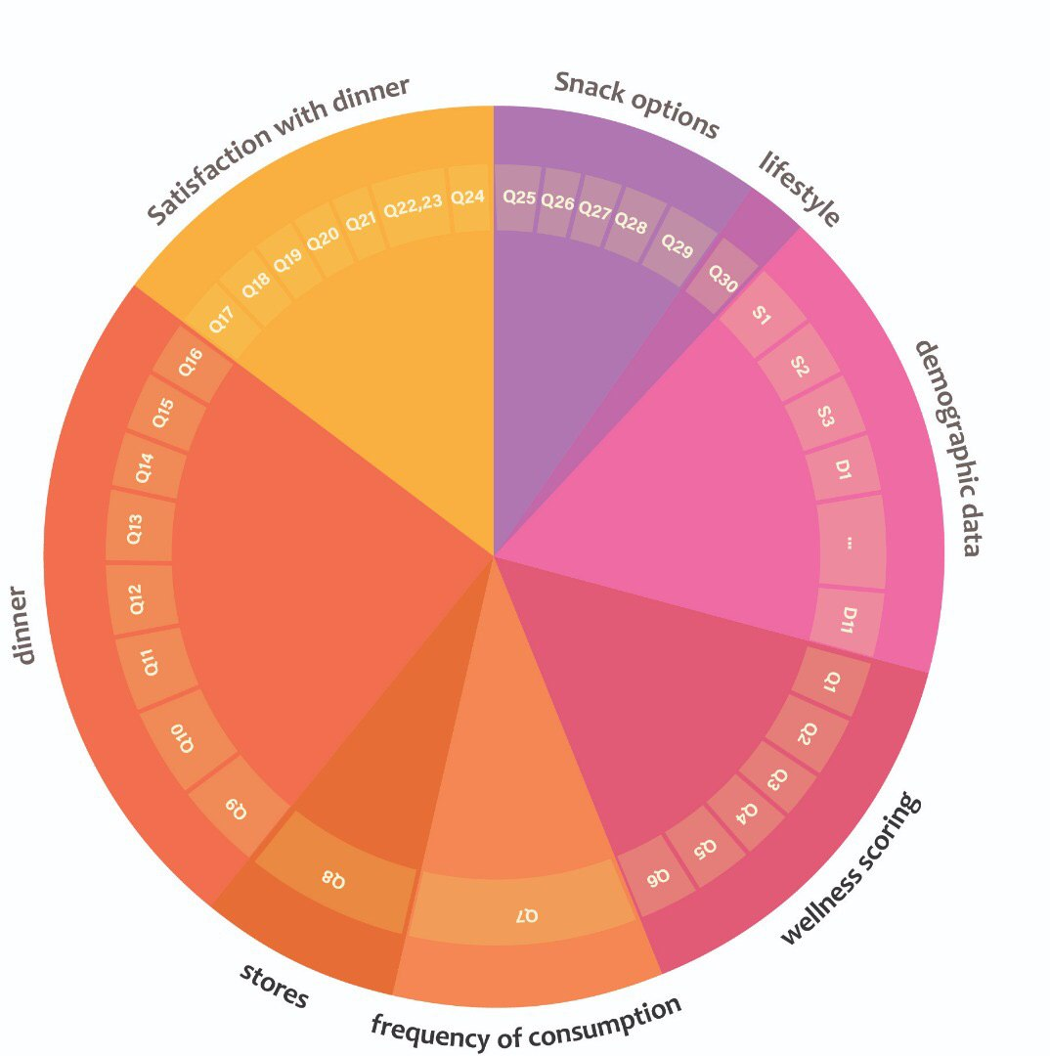
Survey and Data partitions
Demographic Data
Wellness scoring
Food choice and frequency of their consumption
Stores
Dinner choices
Satisfaction with dinner
Snack options
Lifestyle

Slide 9
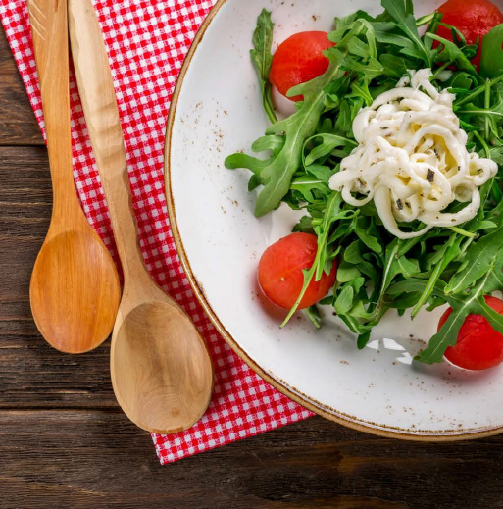
Why is dinner important?
The reason survey such as these focus on dinner is that it is the only time of the day that people (mostly employed) make food. Some people might even make their lunch at that time or take left overs to work. And for people who are interested in taking charge of their health it is important how much time they are willing to spend on making dinner and the choices they make based on this has a defining role in their health and their satisfaction about this routine says a lot about their health and wellbeing.
Therefore a lot of the questions are based on this. And we will explore their behavior and mindset on different aspects of dinner.

Slide 10
Processing and transforming the data
VIZUALIZATION & data cleaning
EDA and Insights
Feature engineering
Donut chart
Bar chart
Stacked bar chart
Distribution plot
histograms
Correlation heat map
We have included all the vizualizations per Question in a separate document.
We have included the important ones in the coming slides and the report.
We have created a new variables for most section of the data trying to capture and summarize their nature and information they have. We mostly have used the score point that the survey makers have suggested unless it was impractical.

Slide 11
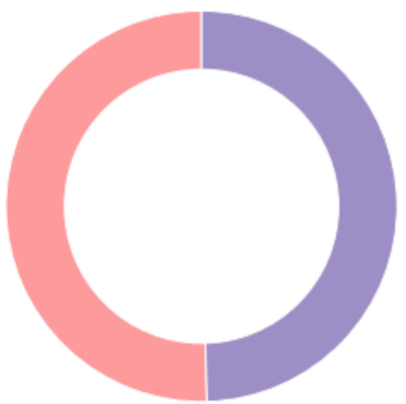
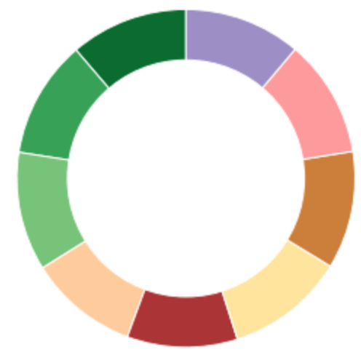

General Demographics
Gender
Age
Male
Female
49.6%
50.4%
18-24
25-29
30-34
35-39
40-44
45-49
50-54
55-59
60-65
11.3%
11.3%
11.4%
10.5%
10.6%
11.4%
11.3%
11.3%
11.2%
Marriage
Married
Not married
30.1%
69.9%

Slide 12
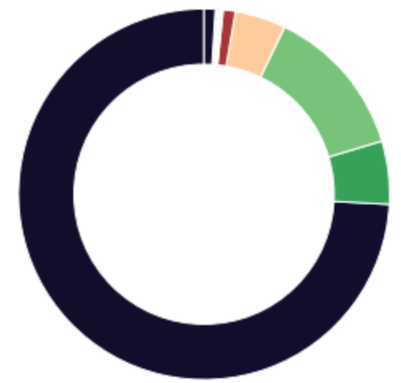
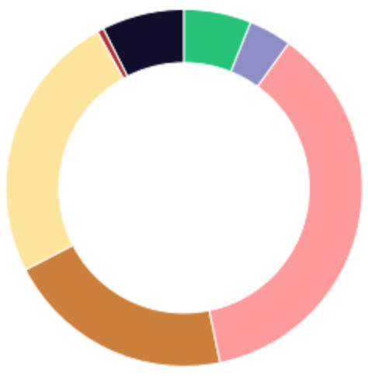
General Demographics Continued
Ethnicity
Education Background
White/Anglo/Caucasian
Hispanic
African American
Asian/Oriental
Indian
Hawaiian
Mixed
South Asian
Caribbean
Italian
middle eastern
pacific islander
Declined
Graduate school
Declined
Bachelor
Grad high school
College
Some high school
Trade/technical
7.5%
0.6%
24.5%
20.6%
36.8%
3.9%
6.1%

Slide 13
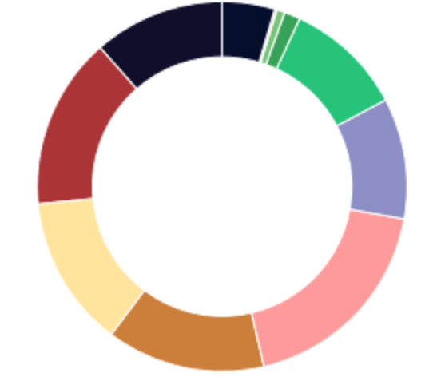
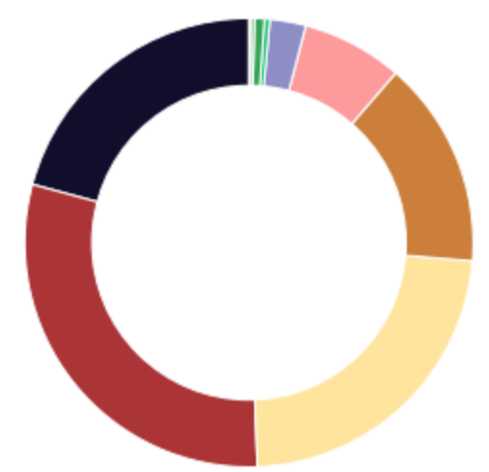
Household Demographics
Household Income
Number of people in the house
<15k
15-25k
25-35k
35-50k
50-75k
75-100k
100-200k
200-300k
300-500k
Declined
11.5%
15.1%
13.3%
13.9%
18.5%
10.6%
10.4%
1.3%
0.6%
4.6%
One
Two
Three
Four
Five
Six
Seven
Eight
Nine
Twelve
20.8%
29.8%
23.1%
14.9%
7.3%
2.6%
0.4%
0.7%
0.3%
0.1%

Slide 14
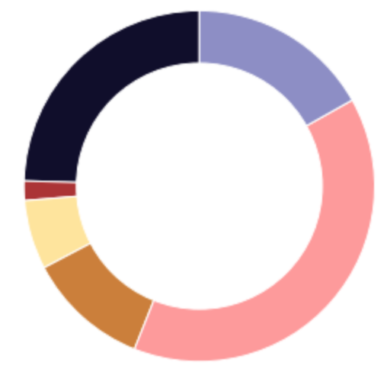
Wellness Demographics
Wellness scoring
Aspiring to wellness
Compromised to wellness
Epitomizing Wellness
Neglected Wellness
Sacrificing Wellness
Scrambling for Wellness
24.5%
1.8%
6.4%
11.3%
39.2%
16.8%

Slide 15
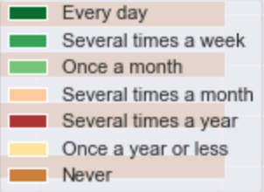
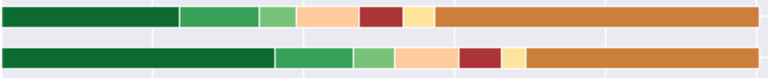
Items that people consume a lot
Cereal
Ground Coffee
Bottle water
Milk
Fresh vegetables
Most of the items that people consume a lot are healthy except for Sugar and Packaged cheese
Fresh Fruit
Multivitamins
Letter Vitamins
Packaged cheese
Sugar

Slide 16
Frequency of item consumption continued
Items that people hardly consume
Scotch
There is no specific pattern. Some of them is because they are rare by itself, some of them is because people have other more popular alternatives like milk for soy milk
Echinacea
CoQ10
Glucosamine
Chia Seeds
Soy Milk
Coconut Milk
Dairy free Cheese
Gin

Slide 17
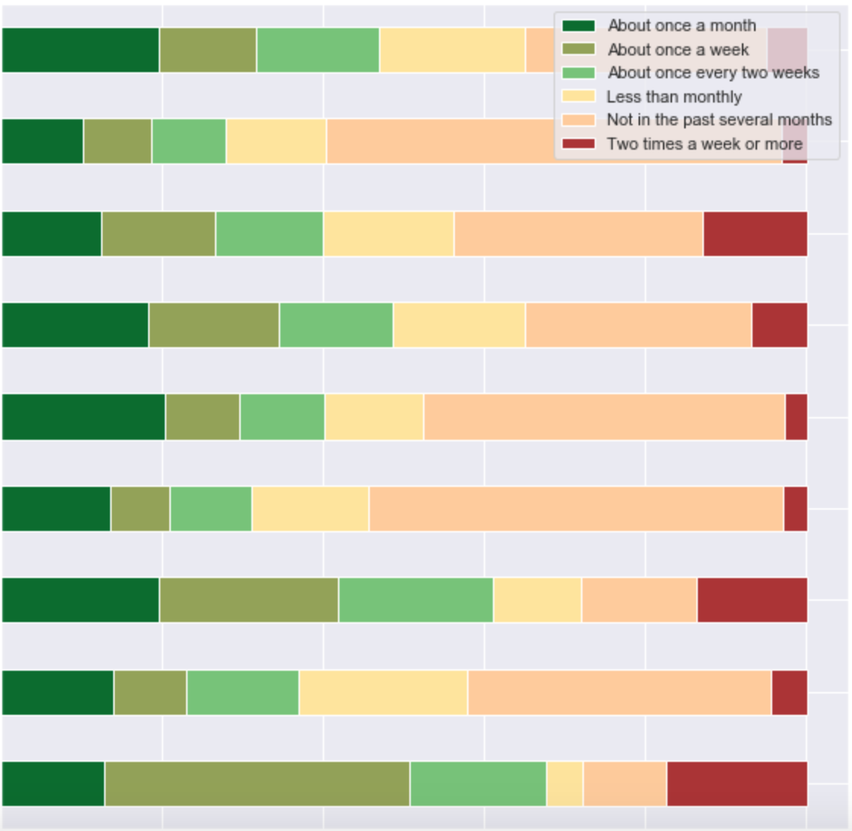
Stores
Traditional grocery store
Frequency of stores that people went to
Target
Walmart
A natural food store like Whole Foods
A club store like Costco or Sam's
People went to pharmacy and convenience store more than others. Few people went to a dollar store or a club store like Costco
A dollar store
A convenience store
A discount supercenter
A pharmacy such as Walgreens or CVS

Slide 18
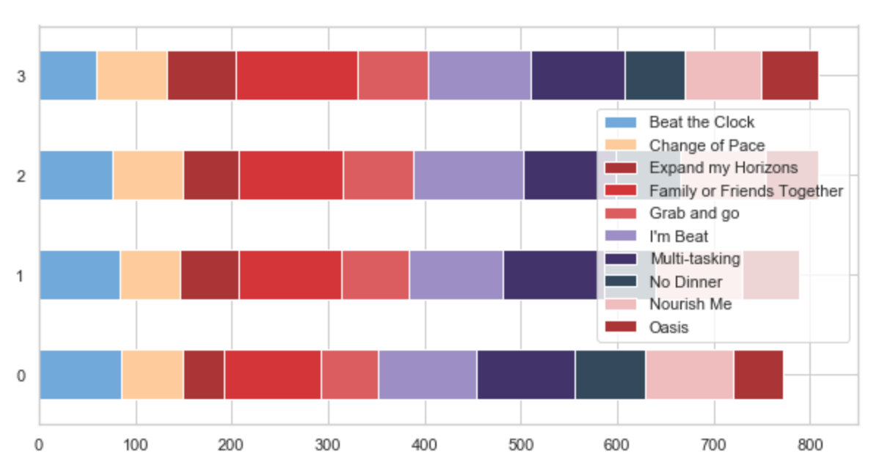
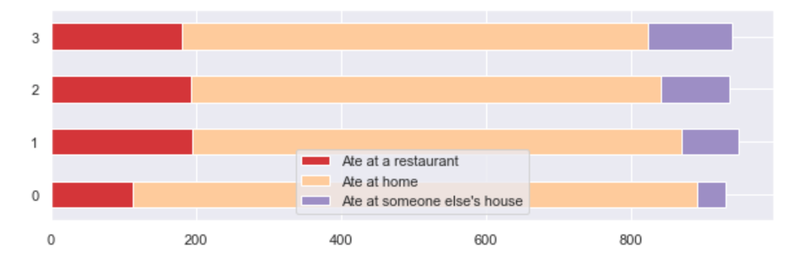
Dinner - Dining and Cooking
Respondents prefer dining with close family and friends, largely multitask also too tired to make dinner at the end of the day.
People mostly dine at home

Slide 19
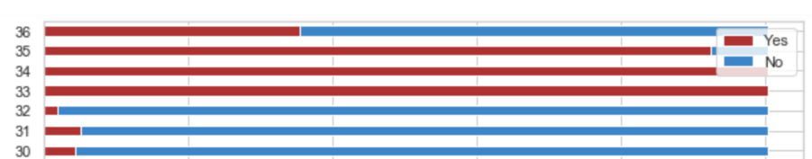
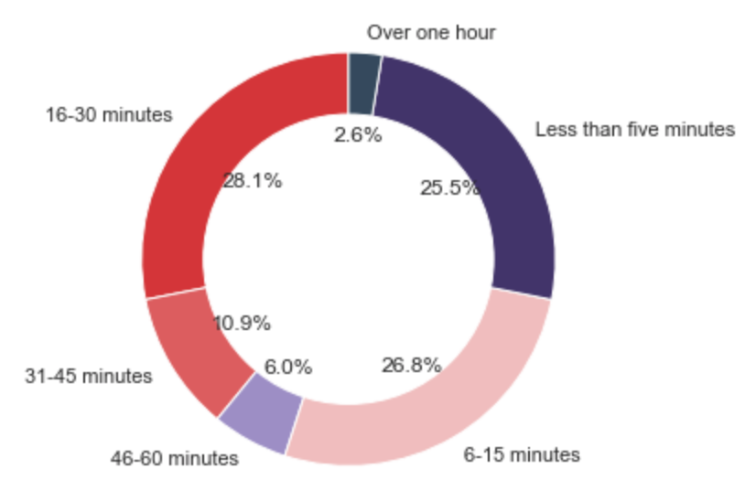
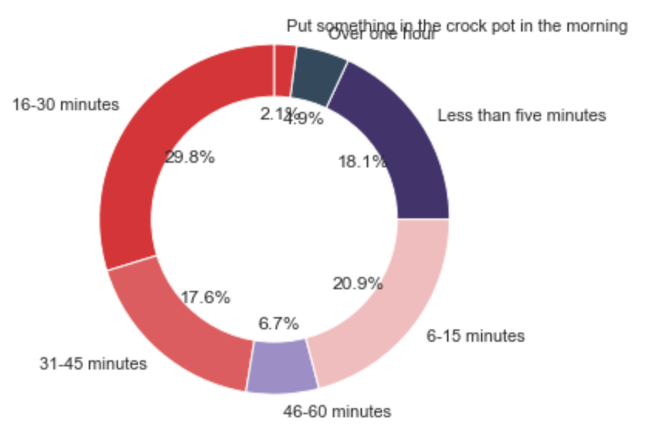
Most consumed dinner choices include leftovers and chicken and some other food type respondents specified.
Next are “Plated Entrée”, “Pizza(not delivered)” and “Salad”
80% of respondents spend under 30 min in preparing food prior to cooking dinner
70% of respondents spend under 30 min to cook dinner

Slide 20
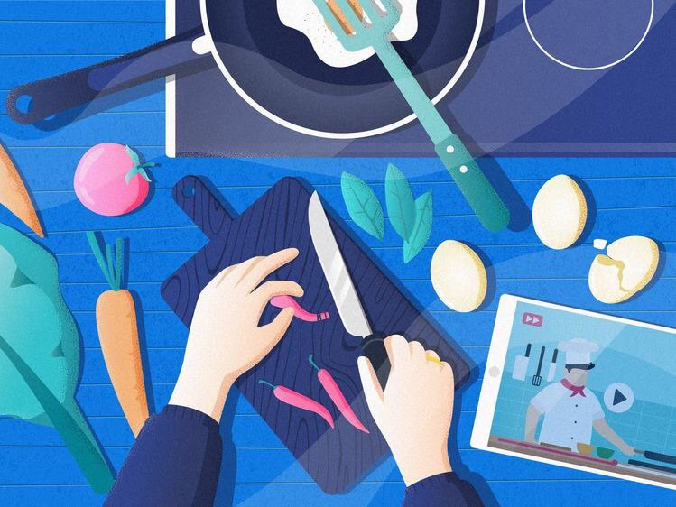
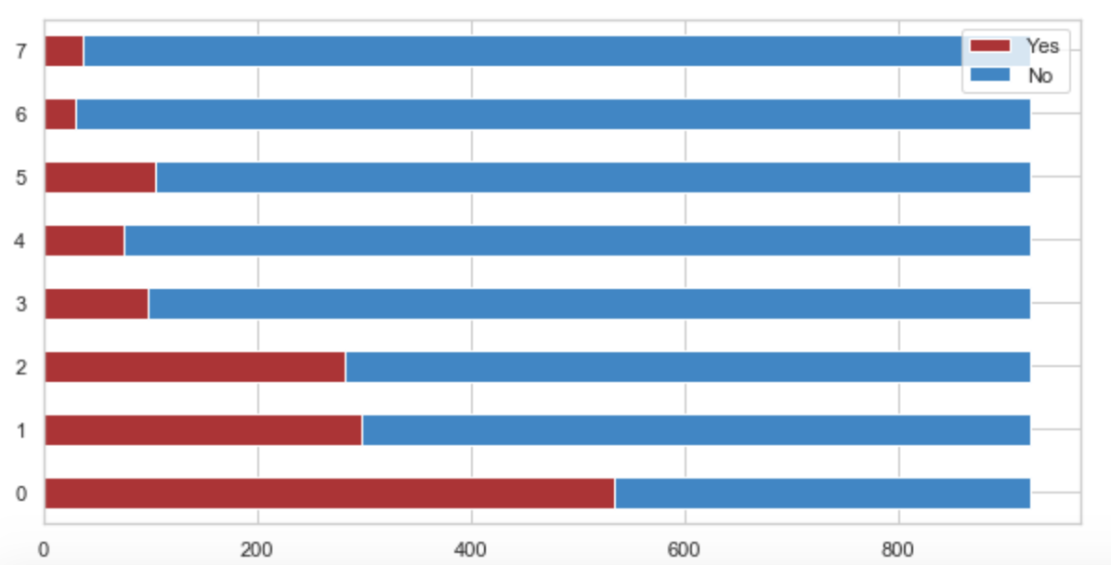
Most used cooking appliance is stove top followed by microwave and oven/broiler

Slide 21
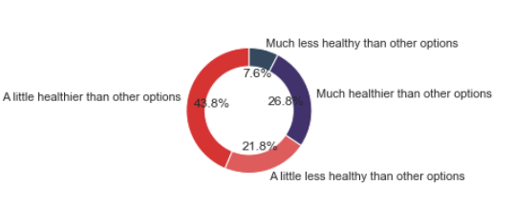
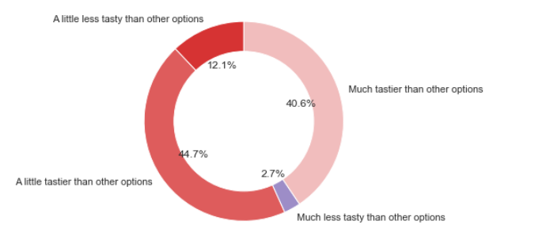
Satisfaction with Dinner
Most respondents (77%) are satisfied with their dinner choices
70.6% of respondents make dinner choices that are healthier than other options
85% respondents prefer dinner choices that are tasty

Slide 22
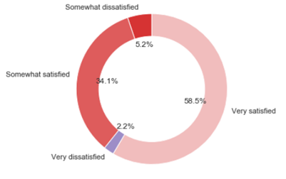
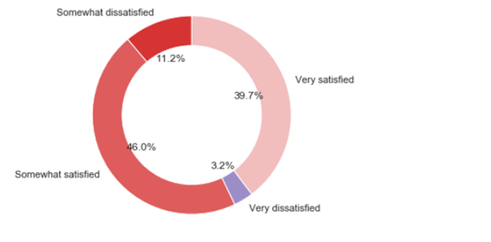
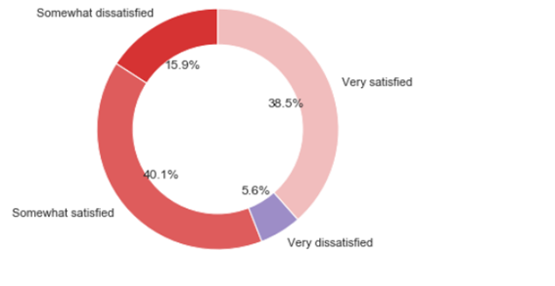
58% respondents felt their hunger was satisfied.
40% not completely satisfied
2% not satisfied at all
Majority of respondents felt their dinner did not completely energize them
61% of respondents do not think their dinner is a well-balanced meal

Slide 23
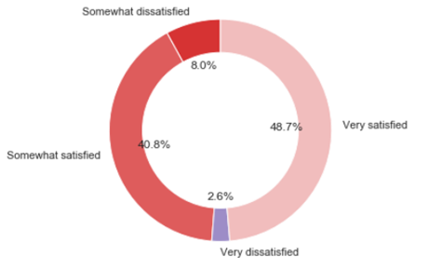
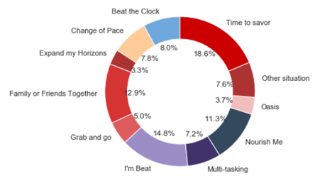
Only 48% satisfied with comfort level of food. More than half (51%) of respondents are dissatisfied
Roughly half the respondents (52.3%) allocate time to eat dinner and (47.9%) do not.

Slide 24
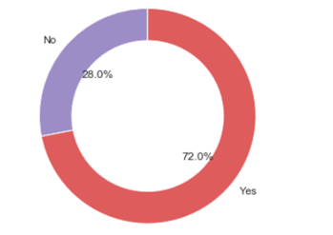
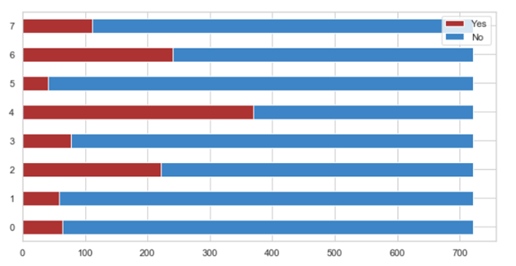
72% of respondents have consumed some type of snack in the past 24 hours
People most commonly have a snack between “lunch and dinner”(51.1%) and “after dinner” (33.24%) followed by “between breakfast and lunch” (30.6%)

Slide 25
Food Related
Other
Profiling the respondents based on criteria here we see the majority
do not actively seek out or believe natural products are good.
do not compromise on taste or convenience for health.
do not regularly consume organic foods and allow junk food into their homes.
however show an inclination toward fresh rather than canned or frozen food,
spend time searching the store for new products
plan their meals ahead of time and prefer high grade food.
Here we see the majority
Do not follow latest trends
Do not strive to achieve high social status or impress others with lifestyle
85% think time with family is priority
79% Seek variety in life
91% like to reward themselves with tasty food
79% buy food based on price
70% prefer food that saves them time in the kitchen.

Slide 26
Health and wellness Indicator (Target variables)
Wellness
We are using the “points” variable.
Levels of point are:
Epitomizing Wellness
Aspiring to Wellness
Sacrificing Wellness
Scrambling for Wellness
Compromised Wellness
Neglected Wellness
Health
We have weight and height data in the, a good indicator of health is BMI(body mass index): weight/height^2
Levels of BMI are:
Underweight
Normal
Overweight
Obese

Slide 27
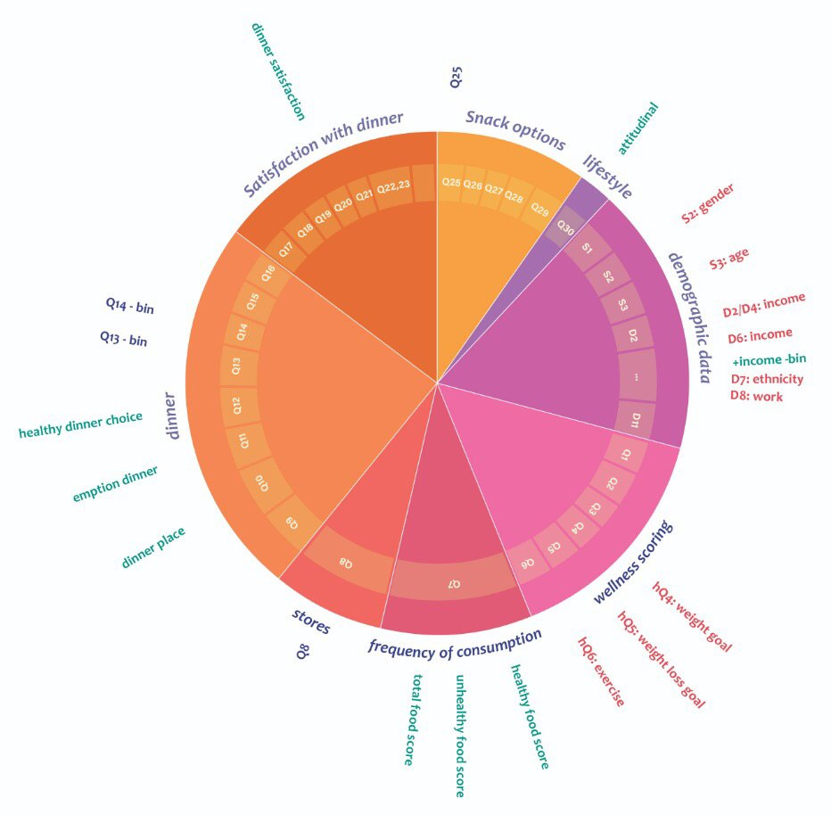
Feature engineering
Attitudinal
Income low –high
Healthy food score
Unhealthy food score
Total food score
Dinner place
Emotion while dinner
Healthy dinner choice
Dinner satisfaction

Slide 28
Data analysis
Feature importance
Machine learning
Clustering and Segementation
In order to choose part of the dataset for linear regression and other prediction algorithms we will be exploring random forests and correlation.
We will explore different Machine learning algorithms to predict wellness and health.
Based on the previous sections and with more feature engineering we will try to use clustering to divide our potential customers into different groups.

Slide 29
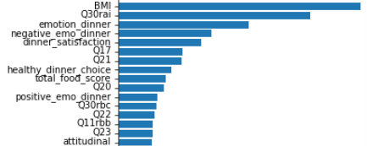
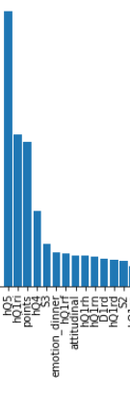
Feature Importance and linear regression
Based on the Random forest algorithm run on all of the data the important features in predicting BMI /BMI group are:
Exercise frequency , wellness, satisfaction with dinner, diet, living alone vs with family members,…
Based on the Random forest algorithm run on all of the data the important features in predicting wellness score “point” / wellness_group are:
BMI (physical health), emotion on preparing dinner, satisfaction with dinner, food score, dinner satisfaction

Slide 30
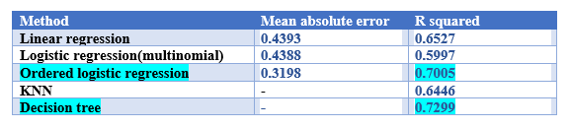
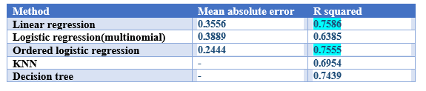
Machine learning algorithms
BMI_group
Wellness_group

Slide 31
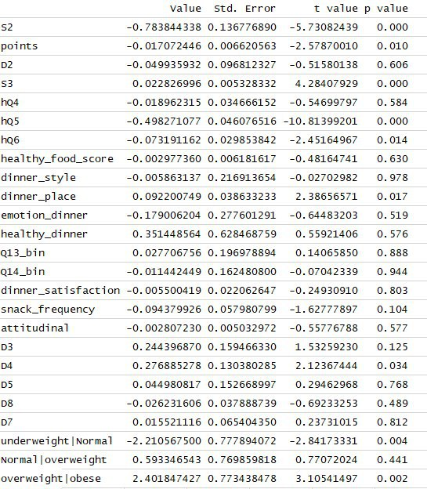
Ordered logistic regression
target variable : BMI

Slide 32
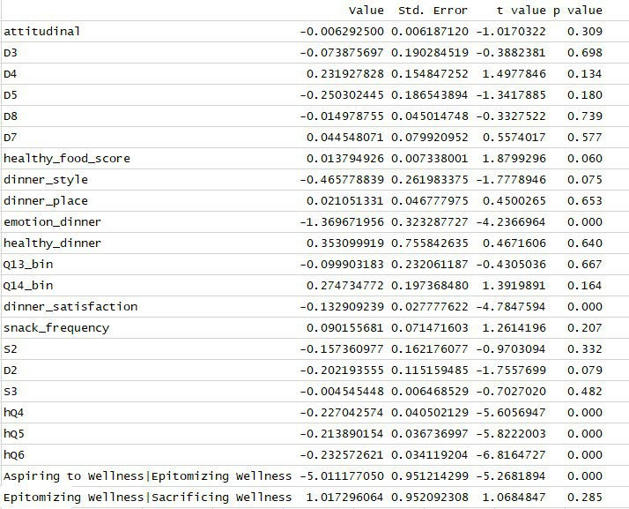
Ordered logistic regression cont.
target variable : Wellness group

Slide 33
Question: Can we predict health & wellness, if so how?
If we measure health by BMI and wellness by the survey’s score system, we can classify people into groups and predict which group a person’s most likely to be in. The best models to predict BMI_group between the 5 models that we have used are decision tree and Ordered logistic regression. The best model to predict Wellness group with is Ordered linear regression (given using linear regression does not make sense for classification.

Slide 34
Important factors(covariates)
The most important features that are associated with BMI_group are:
Wellness_group
marital status
weight loss goal
frequency of exercise
Age
eating at home vs away
family size
The most important features that are associated with Wellness_group are:
BMI
exercise
emotion when making dinner
dinner satisfaction
weight loss goal
frequency of exercise
satisfaction with weight

Slide 35
Clustering for segmentation
Understanding if we can profile/segment people on the following.
Wellness
Food they eat and how often
Demographic info

Slide 36
1. Wellness
Scoring
Based on Q1-6 and the suggested scoring, we categorized users into one of the following groups on the right.
They were then given a score from 0-6, where,
6 = Epitomizing Wellness and
0 = Neglected Wellness
Wellness
We are using the “points” variable.
Levels of point are:
Epitomizing Wellness
Aspiring to Wellness
Sacrificing Wellness
Scrambling for Wellness
Compromised Wellness
Neglected Wellness

Slide 37
2. Foods they eat and how often
Scoring
Based on Q7, we tried to understand how frequently people ate a category of food.
E.g.: How often they ate Frozen foods ?
We looked at each broad category like Frozen, Meat, Alcohol,etc and assigned the highest score people assigned in the survey.
e.g. If they ate frozen instant meals everyday, but a diet frozen meal only once a month, we considered that they ate some form of frozen meal everyday.
The category was then given a score from 0-6, where,
6 = Everyday
0 = Never

Slide 38
2. Food they eat and how often
Categories
The broad categories we considered were
Frozen
Dairy
Produce
Beverages
Meat
Condiments
Breakfast
Bakery
Center of Store
Confection
Sweeteners
Supplements
Alcohol
Scoring scale per category
6 – Everyday
5 – Several times a week
4 – Several times a month
3 – Once a month
2 – Several times a year
1 – Once a year or less
0 – Never

Slide 39
3. Demographic Info
Variables
The Variables we considered are:
Number of dietary restrictions
People in Household
Whether married/living in
Number of children
Education Level
Income Level
Ethnicity
Work Situation
Height
Weight
Some of the categorical/ordinal variables above were transformed

Slide 40
3. Demographic Info
Variable Transformation
Number of dietary restrictions
We aggregated all dietary restrictions a household had.
E.g. if they were vegetarian and did not eat gluten, we assigned a value of 2 to the given household.

Slide 41
3. Demographic Info
Variable Transformation
2. Education Level
We considered this as an Ordinal variables and assigned a score from 0 -5
0 = Some high school or less
6 = Attended graduate school or received Advanced degree (Master's, Ph.D.)
For those who declined to answer, we imputed the mode

Slide 42
3. Demographic Info
Variable Transformation
3. Work Situation
We considered this as an Ordinal variables and assigned a score from 0 - 8
0 = Less than USD 15,000
8 = Greater than USD 500,000

Slide 43
Running the Clustering Algorithm
Step 1: Standardizing
Given that Clustering is sensitive to scale, we standardized the data using Standard Scaler
Mean of each column = 0
SD of each column = 1

Slide 44
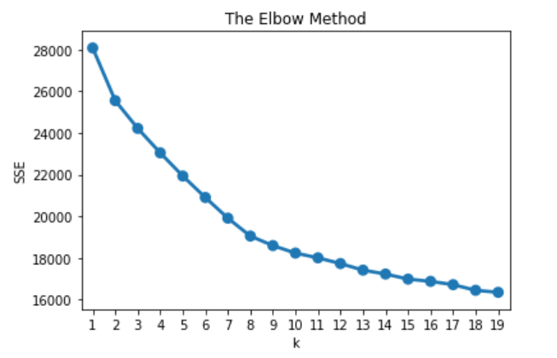
Running the Clustering Algorithm
Step 2: Picking the ideal number of clusters
We used K-means and Hierarchical clustering
For K means we tried every value between 1 – 20 for K
Using results from each value of K, we plotted an elbow chart.
From the chart we decided to pick 8 as the ideal value for K.

Slide 45
Running the Clustering Algorithm
Step 3: Running Kmeans and assigning cluster labels
We ran K- means for K = 8
To understand our clusters we
We assigned the cluster labels to each observation
We then took the mean for every variable grouping by the cluster labels.
The means were then plotted on a Parallel Coordinate plot to
understand the clusters better.

Slide 46
Running the Clustering Algorithm
Step 3: Parallel Co-ordinate plot:
Link to plot

Slide 47
Understanding Clusters characteristics
Cluster 0: The educated and wealthy
High Income score
Work fulltime
High education
Eat frequently from each food category
Highest supplement and alcohol consumers
Have at-least one child on average
Cluster 1: The low income and not employed
Unmarried and no children on average.
Low education and Income
Low consumption of confectionary and frozen foods
Lowest amongst the wellness score
Not currently employed
Note: Cluster number colours represent line colours of the cluster on the parallel coordinate plot.

Slide 48
Understanding Clusters characteristics
Cluster 2: The Homemaker
Stay at home/homemaker
Maximum people at home
Highest number of children
Moderate household income
High consumption of frozen, dairy, meat, breakfast and bakery items.
Lower on the wellness score
Lowest education score aswell
Cluster 3: The Retired
Retired people
No children at home
Lowest score on people at home
High beverage consumption
Highest consumption in Sweeteners, confection and supplements.

Slide 49
Understanding Clusters characteristics
Cluster 4: The White collar worker
High education score
High Income
Works full time
Average consumption across most categories of food
High consumption of alcohol and supplements
Cluster 5: The part time working warrior
Work part time
Well educated, but moderate income
Highest center of store consumption

Slide 50
Understanding Clusters characteristics
Cluster 6: The frugal consumer
Lowest average consumption across all food categories
No defined work situation
Average education
Average Income
Mostly unmarried without children.
Cluster 7: Lone ranger, looking for employment
Largely unemployed but looking for work.
Unmarried
Second lowest income and education.
Low wellness score aswell.

Slide 51
Recommendations
Our recommendation is that based on the dataset and the insights we have shown in this report to address the needs of our customers the company should follow this three-level plan:
Target the people who don’t have time to make meals.
Target the people who snack between lunch and dinner with healthy snacks.
Use the clusters to target marketing for our products and address different demographics

Slide 52
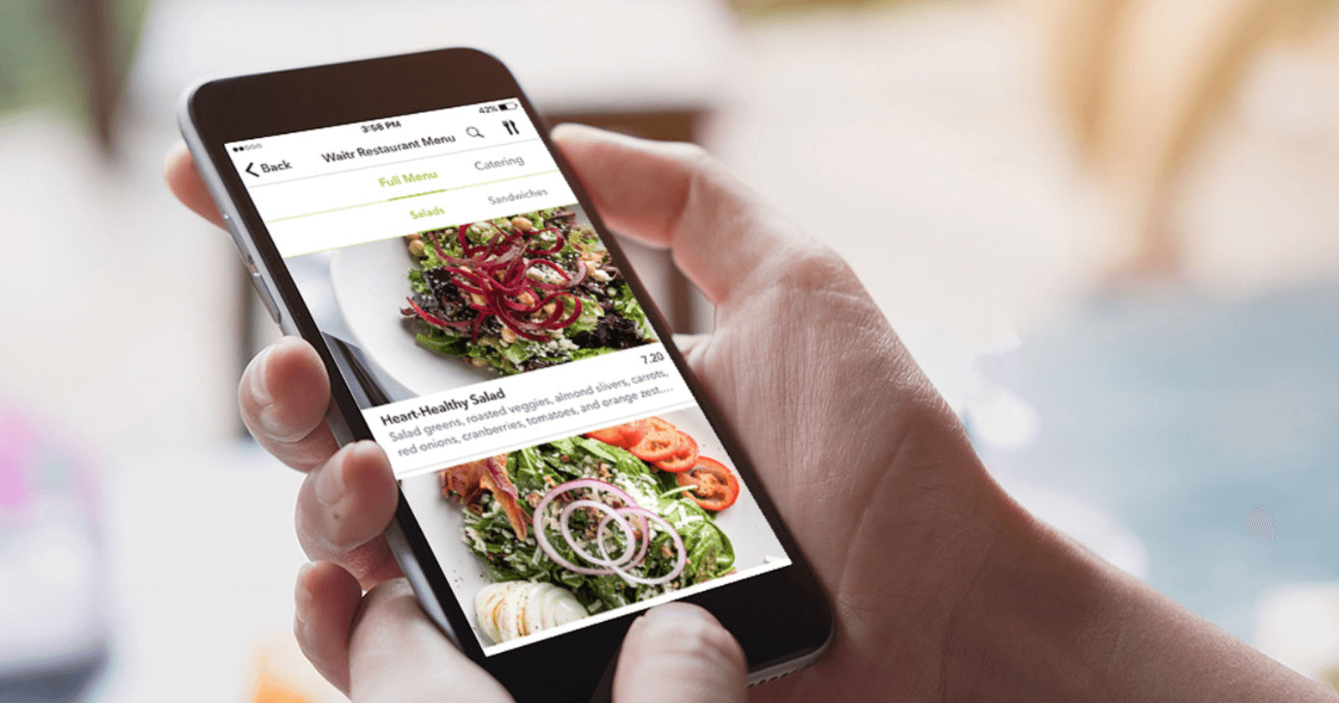
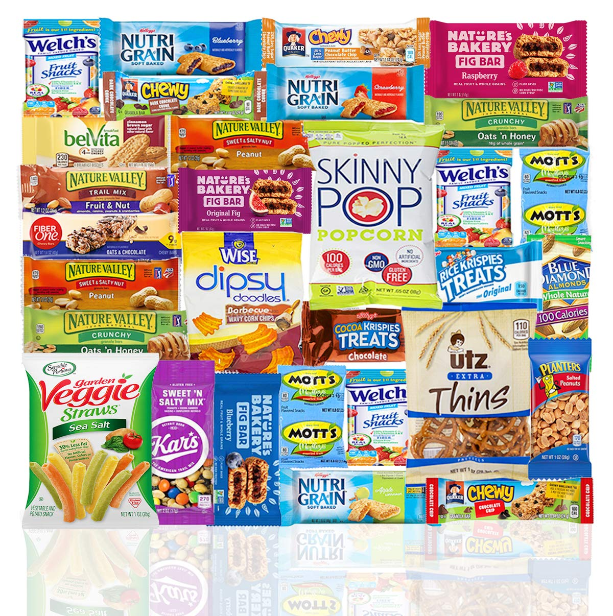
Recommendations cont.
We also suggest in order to shorten customer’s food preparation and cooking time the company pursue presenting them with a service that cuts that time for example with providing the ingredients from the stores the customers have mentioned they acquire the food from like providing a medium such as an app for customers to address their diets and special needs and food requests.
Also the company can use this data to attract healthy snack brands and help them develop and market the snacks.

Slide 53
Thank you for your time and attention

